Slide 1

ONLINE GIFT SHOP PROJECT

Slide 2

UNIVERSITY INSTITUTE OF TECHNOLOGY, RGPV BHOPAL
Guided By: Presented By:
Mr. Jay Narayan Thakre Laxmi Kushwah

Slide 3
ABSTRACT
This project is aimed at developing a Web application that depicts online Shopping of gifts. It integrates the benefits of an ordering products with the convenience of an online excitement and going with the technology, minus the commuting hazards and expenses. It will usher in the immense flexibility and sophistication in the existing manual platform structures, with the perfect blend of synchronous and asynchronous interaction. It provides a means of collaborative E-ordering for the customers.

Slide 4
MODULES
Customer module
View Products
Product Booking
Give Feedback
View Product Bookings

Slide 5
MODULES
Administrative module
Manage Products
Manage Booking
Manage Customers
Manage Feedback

Slide 6
Administrative module
Administrative module is provided for the sake of administrators to manage the site and update the content at regular intervals, The major operations included in this module are:
Create and maintain product categories.
View the product available.
Update product information.
Remove the product.
View Customer information and Bookings.

Slide 7
Customer module
This module is meant for customers, where a user logging into his/her owns account will view this panel. The major operations included in this module were
View all available products and its price , description and other details etc.
View Our Booking.
View and cancelling of the product booking.
Send feedback

Slide 8
PURPOSE
To manage the online gift products ordering. It helps to customer to book products from anywhere. Also make payment on delivery. It helps to people to book desired products at their prefer time.

Slide 9
SCOPE
The project has a wide scope, as it is not intended to a particular organization. This project is going to develop generic software, which can be applied by any businesses organization. More over it provides facility to its customer. Also the software is going to provide a huge amount of summary data.

Slide 10
PROPOSED SYSTEM:
The Proposed system ensures the complete freedom for users, where user at his own system can logon to this website and can book his product. Our proposed system allows only registered users to book the product, view booking and cancel their booking as per their need.
In this Proposal the entire work is done on online. Here customer can send their queries and suggestions through a feedback form.

Slide 11
Software Used :
PYTHON INTERPRETER
PYCHARM IDE
Chrome or Any Other Browser

Slide 12
FrontEnd :
HTML(Hypertext Markup Language)
CSS(Cascading StyleSheet)
Bootstrap(Library of HTML,CSS and JS)

Slide 13
BackEnd :
PYTHON DJANGO
SQLITE(DATABASE)

Slide 14
SYSTEM DESIGN
Unified Modeling Language:
UML stands for Unified Modeling Language. It is a third generation method for specifying, visualizing and documenting the artifacts of an object oriented system under development. Object modeling is the process by which the logical objects in the real world (problem space) are represented (mapped) by the actual objects in the program (logical or a mini world). This visual representation of the objects, their relationships and their structures is for the ease of understanding. This is a step while developing any product after analysis.

Slide 15
The Unified Modeling Language encompasses a number of models.
Use case diagrams
Class diagrams
Sequence diagrams

Slide 16
Use Case Diagram:
Use case diagram consists of use cases and actors and shows the interaction between them. The key points are:
The main purpose is to show the interaction between the use cases and the actor.
To represent the system requirement from user’s perspective.
The use cases are the functions that are to be performed in the module.
An actor could be the end-user of the system or an external system.

Slide 17
Manage Products
Manage Feedback
Manage Booking
Manage Users
Use Case Diagram between ADMIN and SYSTEM:

Slide 18
Booking
Cancel
Search
Feedback
Use Case Diagram between USER and SYSTEM:

Slide 19
Sequence Diagram:
The purpose of sequence diagram is to show the flow of functionality through a use case. In other words, we call it a mapping process in terms of data transfers from the actor through the corresponding objects.

Slide 20
SEQUENCE DIAGRAM

Slide 21
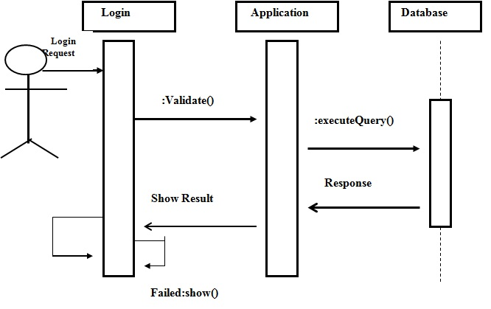

Slide 22
ER DIAGRAM

Slide 23
Level 0 - DFD
System
Database
Input Output
Level1
Admin/User
Enter the site
Authenticate User
Check whether Admin or customer
Display errors
Customer
Admin
View product
Buy product
Check products
Verify customer
Products
Customer details

Slide 24
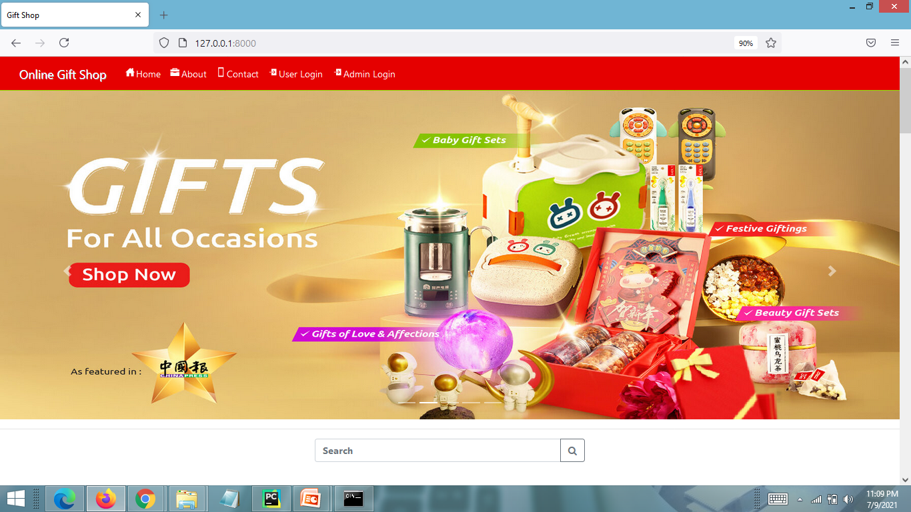
SCREEN SHOTS

Slide 25
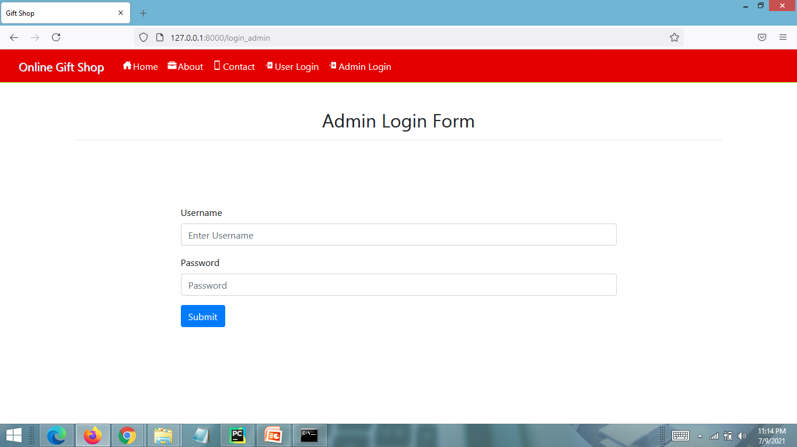
ADMIN LOGIN FORM

Slide 26
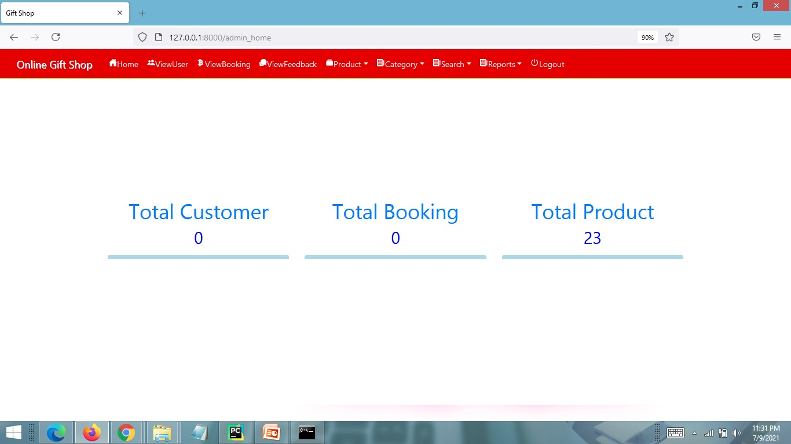
ADMIN HOME PAGE

Slide 27
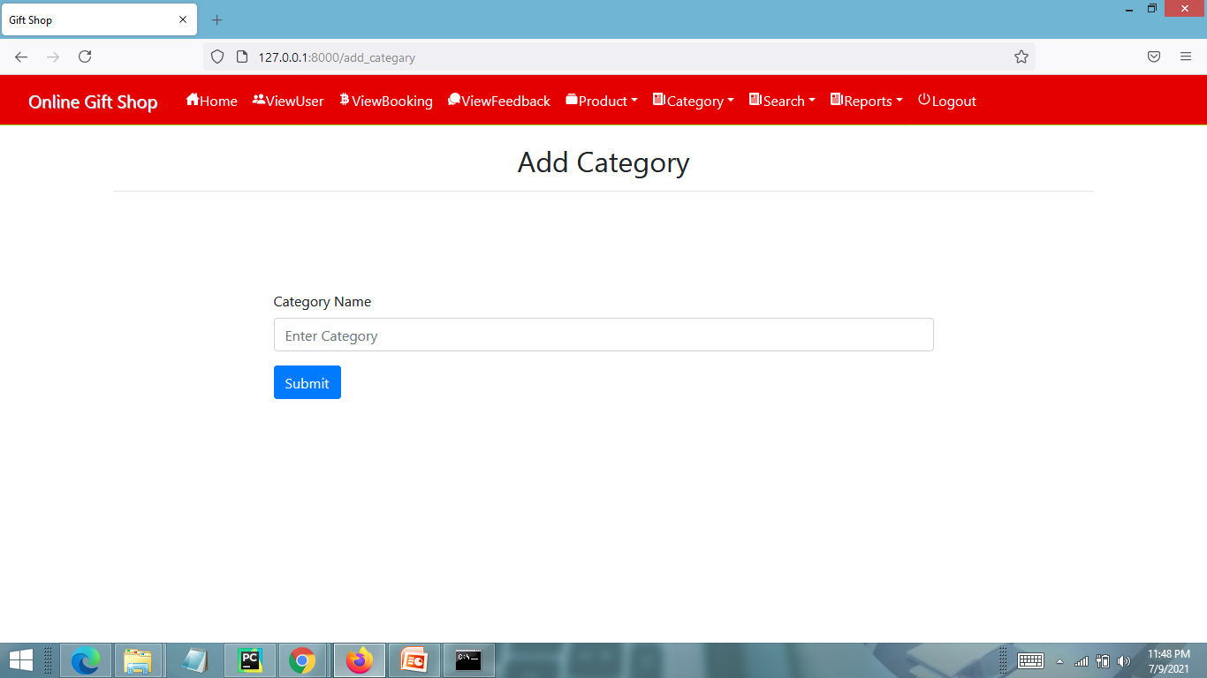
ADD CATEGORY PAGE

Slide 28
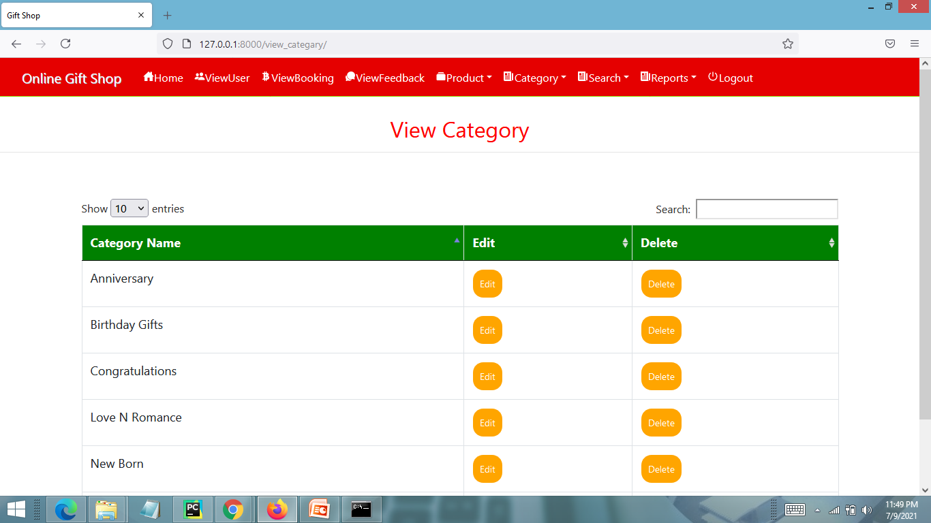
VIEW CATEGORY PAGE

Slide 29
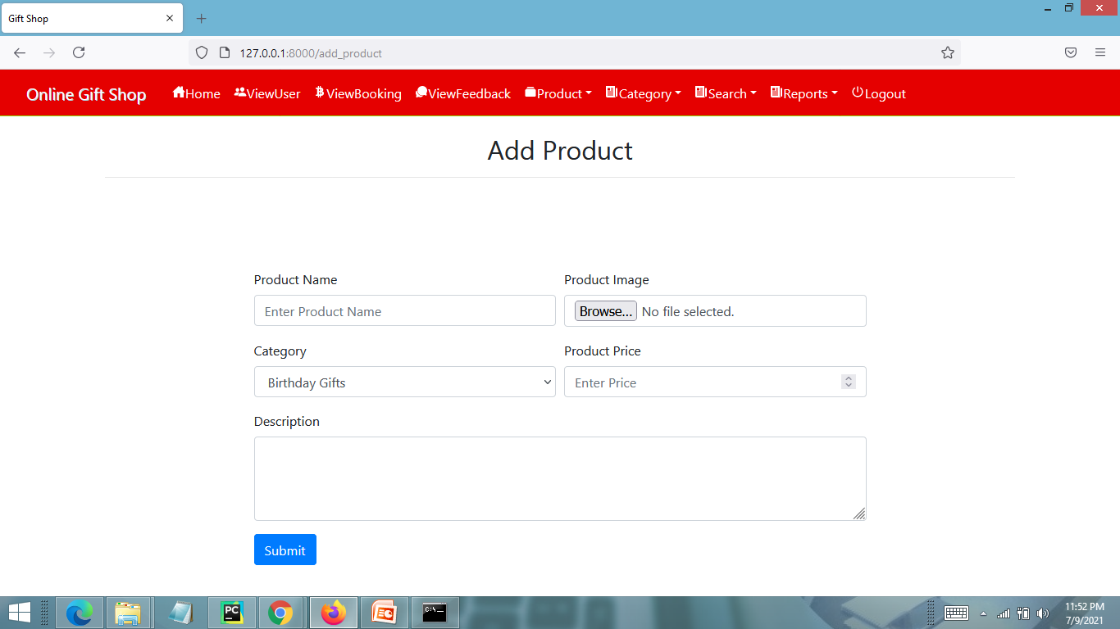
ADD PRODUCT PAGE

Slide 30
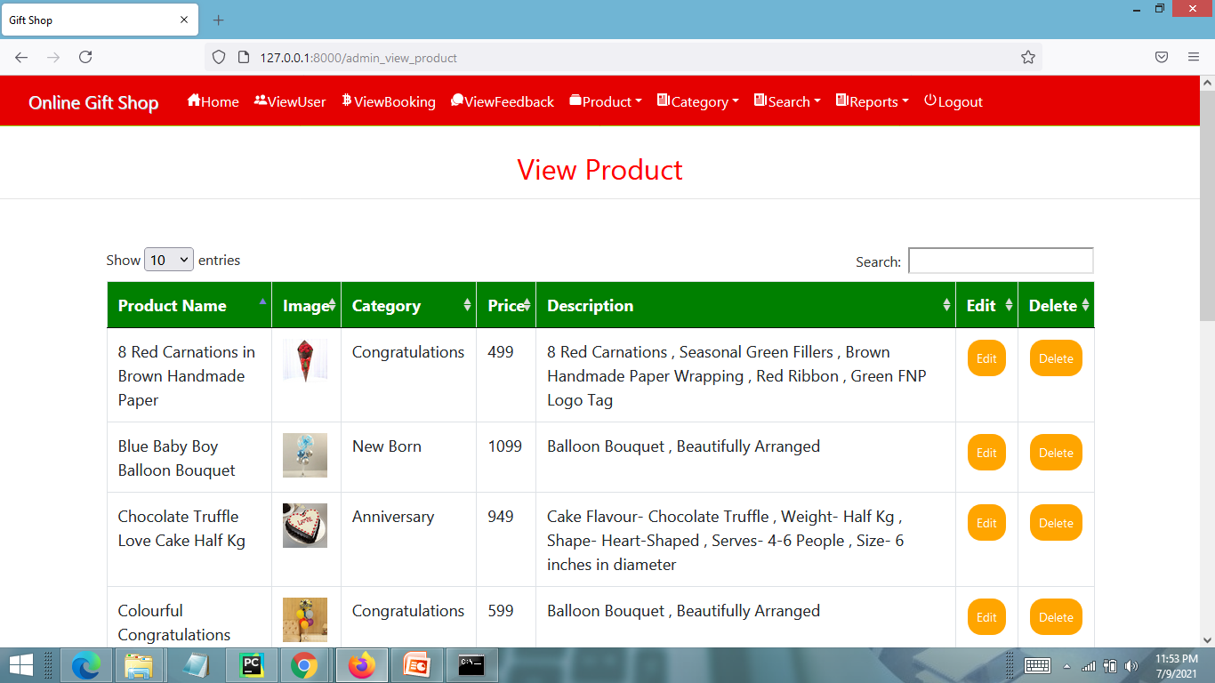
VIEW PRODUCT PAGE

Slide 31
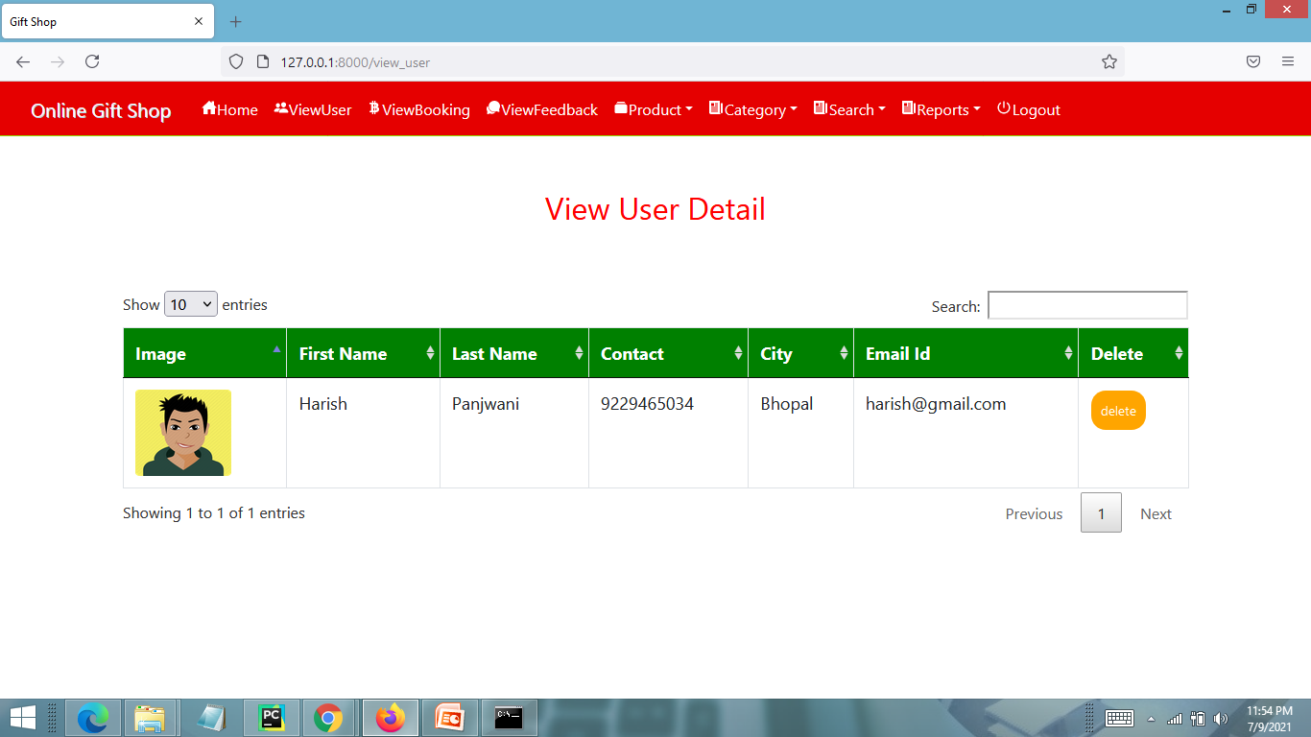
VIEW REG. USERS PAGE

Slide 32
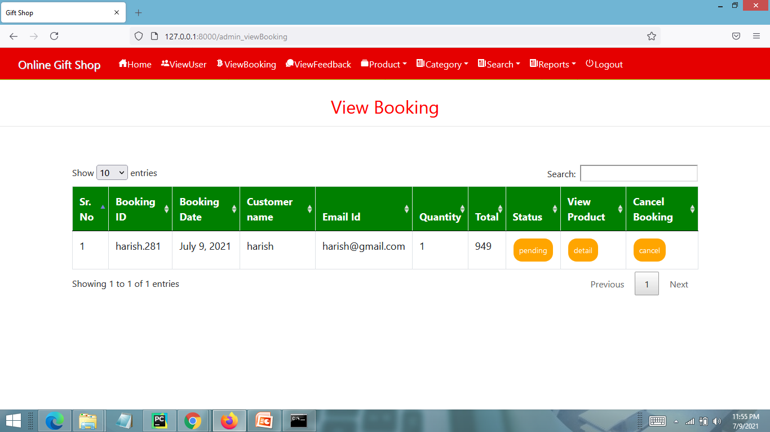
VIEW ALL BOOKINGS PAGE

Slide 33
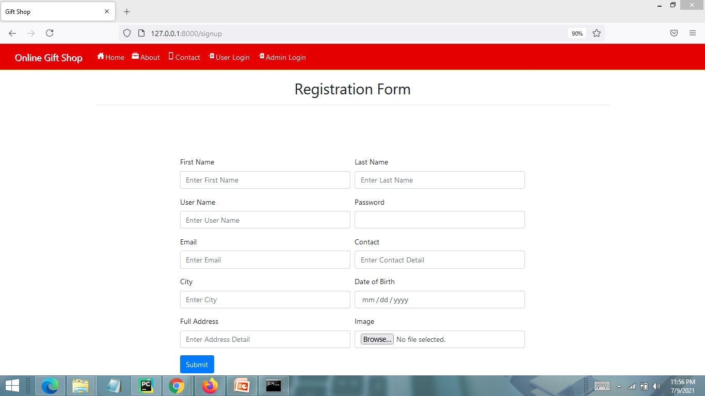
USER REGISTRATION PAGE

Slide 34
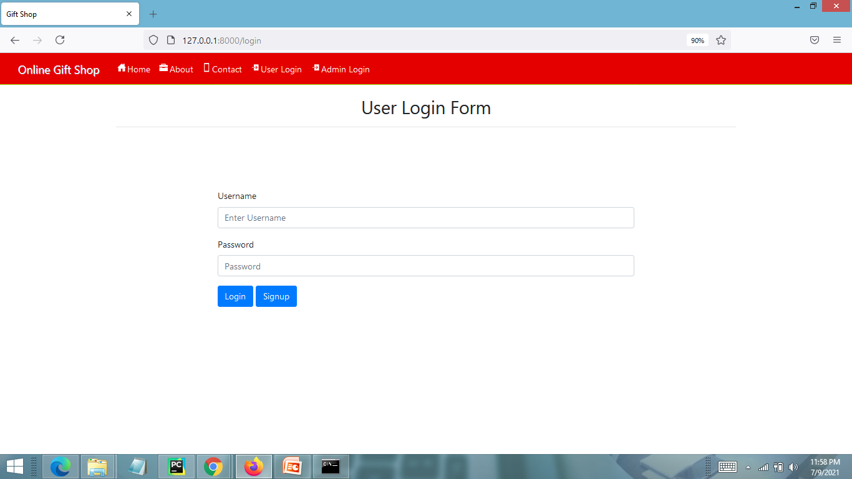
USER LOGIN PAGE

Slide 35
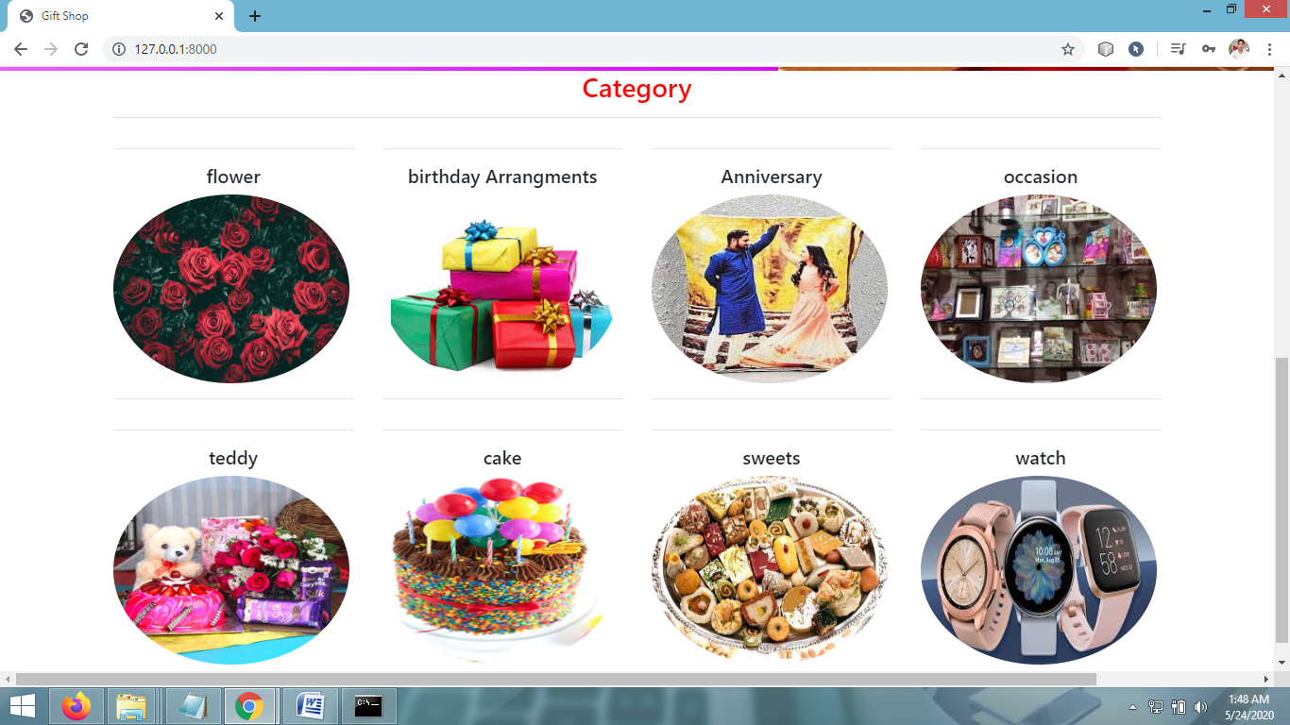
VIEW PRODUCTS CATEGORY PAGE

Slide 36
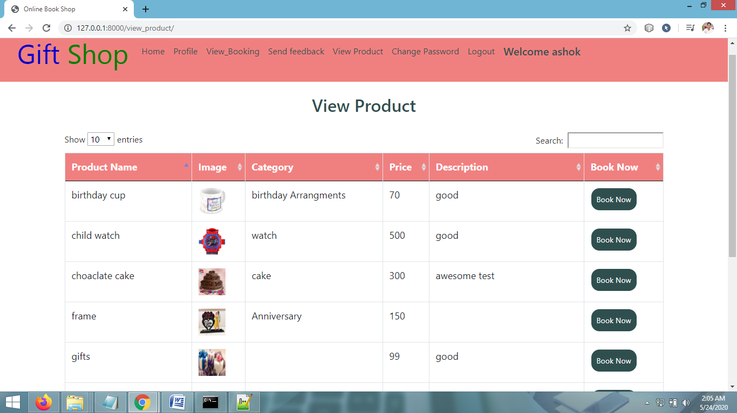
VIEW PRODUCTS PAGE - USER

Slide 37
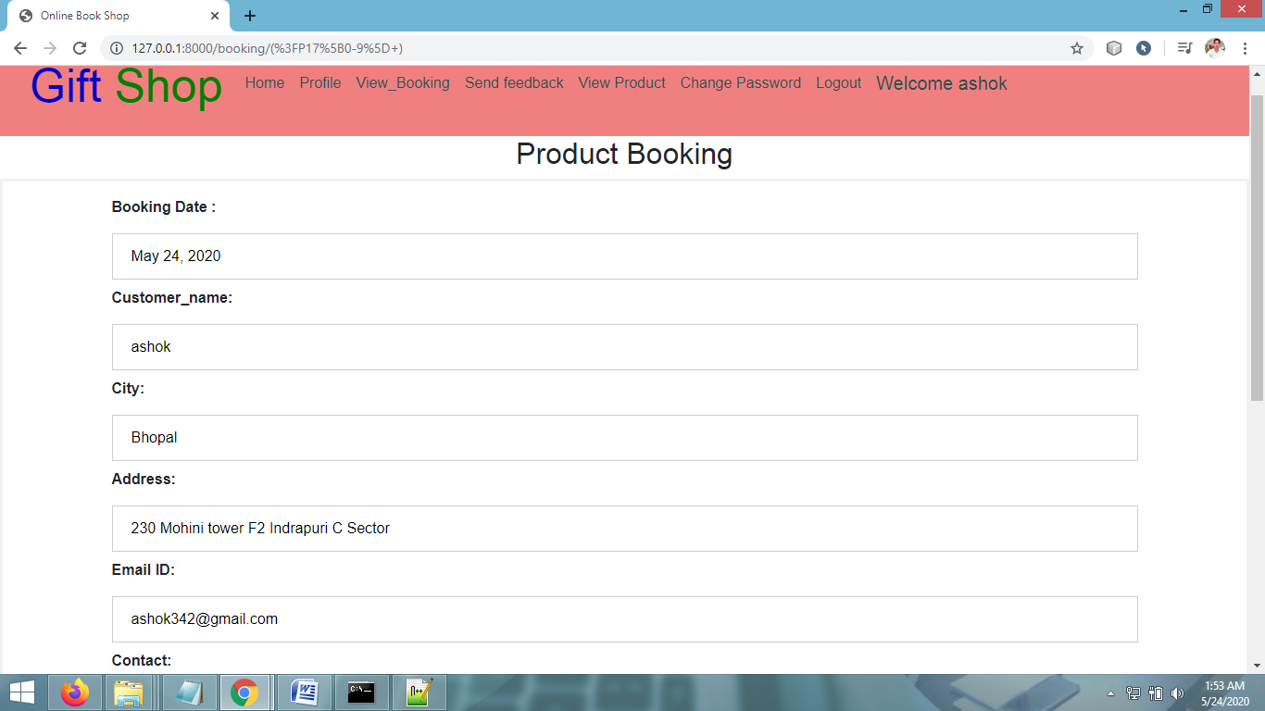
PRODUCT BOOKING PAGE

Slide 38
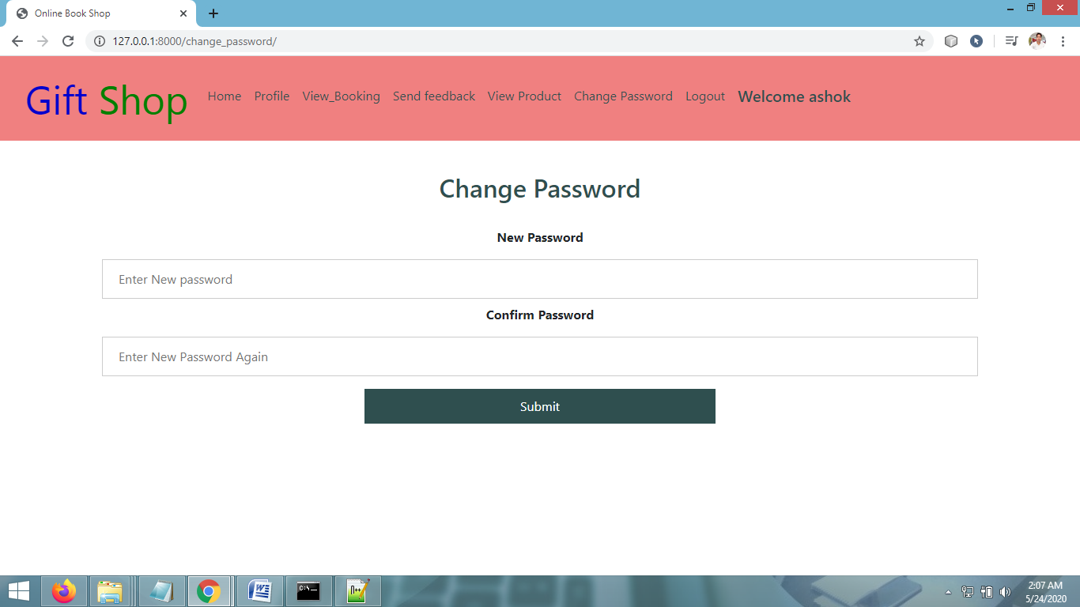
CHANGE PASSWORD PAGE

Slide 39
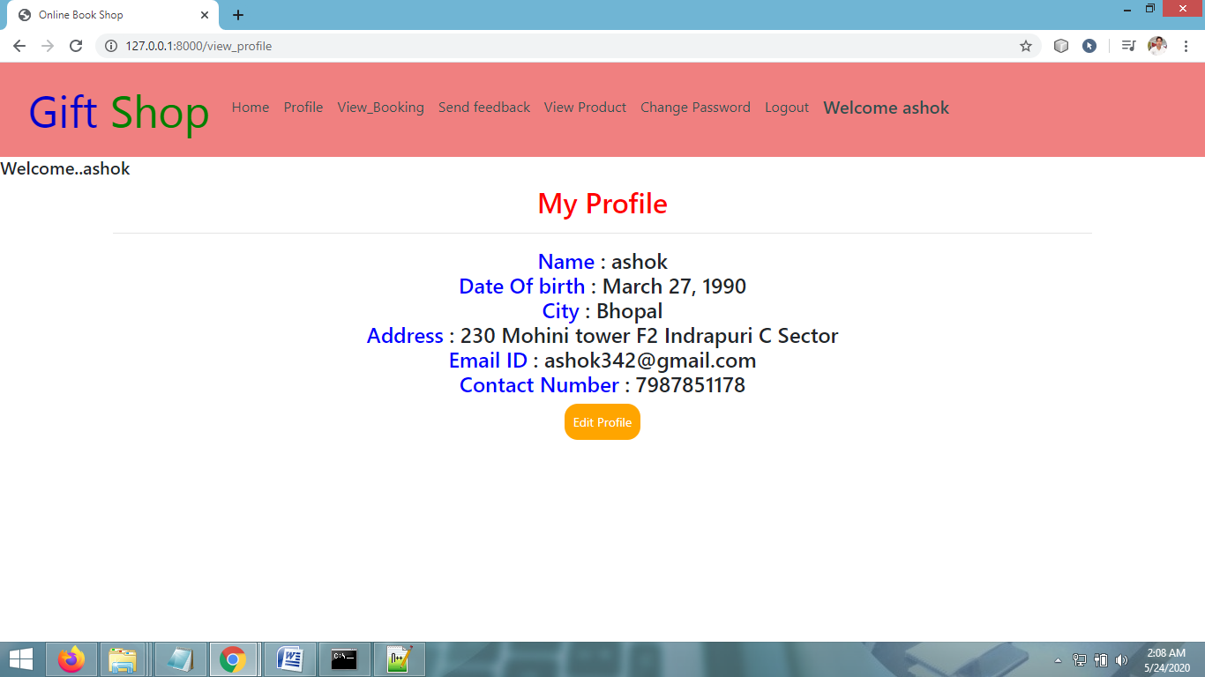
VIEW PROFILE PAGE

Slide 40
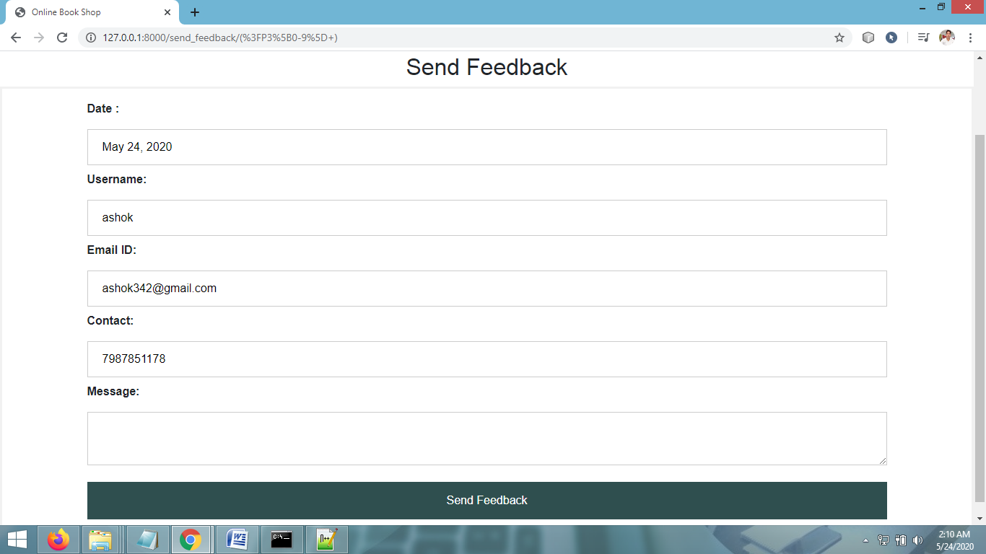
SEND FEEDBACK PAGE

Slide 41
CONCLUSION & FUTURE SCOPE
FUTURE SCOPE
This web application involves almost all the features of the online shopping. The future implementation will be online help for the customers and chatting with website administrator.
CONCLUSION
The project entitled “Online Gift Shop” is developed using HTML , CSS and Bootstrap as front end and Python , Sqlite database in back end to computerize the process of online shopping. This project covers only the basic features required.

Slide 42
BIBLIOGRAPHY
Wikipedia
https://www.geeksforgeeks.org/python-django/
https://www.javatpoint.com
https://www.python.org/
https://www.tutorialspoint/
REFERENCE BOOKS
Two scoops of Django for 1.11 by Daniel Greenfeld’s and Audrey Greenfield
Lightweight Django by Elman and Mark Lavin

Slide 43
THANKYOU

